Slide 1

“Chat Pi” Your Private Assistant
Team Member:
Yanghonghui Chen yc47
Haoyu Huang haoyu3
TA: Neo Yuan
Work Partition:
Haoyu Huang: Set up the data transmission between PC and Raspberry pi through google cloud, deploy facial recognition model via API and Invoke ChatGPT API
Yanghonghui Chen: Set up, train and evaluate the speaker recognition model locally & Deploy the model on Raspberry Pi , prepare slides for presentation

Slide 2

Motivation & Problems
1. Motivation:
Addressing the need for privacy and security in IOT devices.
Providing users with a more convenient means of interacting with personal assistants.
Making the IOT assistant more personalized.
2. Existing solutions:
Standalone Chatbot voice assistant without any access protection.
Our approach combines facial or speaker recognition with AI-based chatbots for comprehensive security and personalization.
3. Challenges:
Ensuring accuracy and reliability of facial or speaker recognition models.
Reducing the response time and making the interaction smoother.
4. Strategies for improvement:
Increasing the size of the training dataset and improve the model design to improve the recognition accuracy
Deploying the models on the server to reduce the workload of Raspberry pi and speed up the response time.

Slide 3
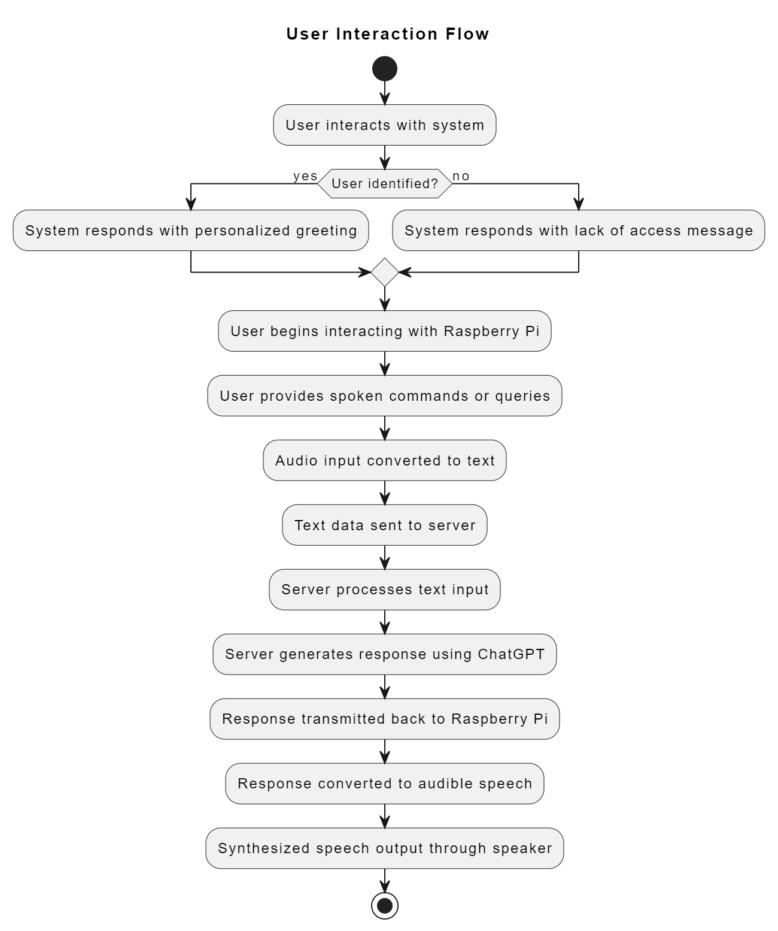
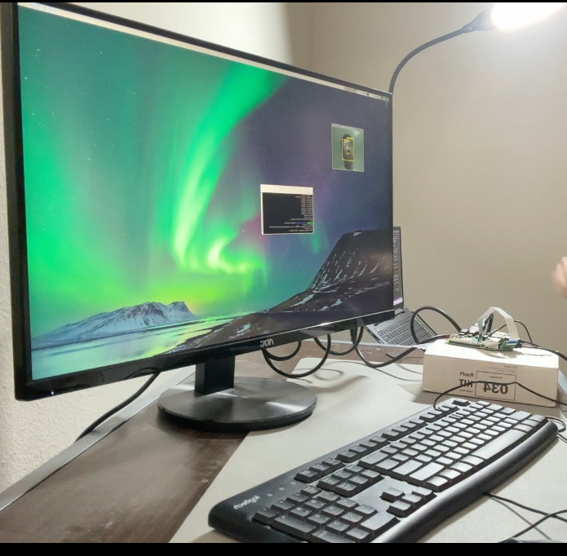
Design and Methodology

Slide 4
Technical Details
1. Facial Recognition
Library: Face Recognition
Built on: dlib library
Training:
Used 100 pictures for training.
Extracted facial features for comparison.
Performance:
Accuracy not high, still in development.
Goal: Improving accuracy, modifying approach.
2. Speaker Recognition
Model Reference: Keras Speaker Recognition
Features:
Preprocessing with librosa.
Extraction using MFCC.
Model:
Built with Keras, employing CNN and residual blocks.
Data:
Initial failure with audio data from laptop microphone.
Recorded 100 audio files per person with Pi microphone.
Achieved 96% accuracy on the test datasets containing 120 random audio files.
Goal: Increasing dataset size for robustness.

Slide 5
Technical Details
3: Speech to Text
Library: Speech Recognition
Features:
Python library for speech recognition tasks.
Easy-to-Use: Provides simple functionalities.
4: Text to Audio
Packages: GTTS (Google Text-to-Speech), Pygame.
GTTS: Converts text to speech using Google’s API.
Pygame: Used for playing audio files.
5: ChatGPT API
Product: OpenAI ChatGPT
Interaction:
Interact with OpenAI API for responses.
Send requests, receive responses.
6: Google Cloud Storage
Package: google.cloud.storage
Functionality:
Upload and download files (audio, questions, answers).
Server continuously checks for new questions, generates responses using ChatGPT API, and sends them back to the client.
Client waits for responses, overwrites questions with results.

Slide 6


Preliminary Results

Slide 7

Future Work
Increase the size of the face image dataset taken by the Pi camera, use the images to train our own neural network model from Lab2, and then deploy that on the Raspberry Pi.
Increase the accuracy of the speaker recognition model.
Try to add more functions like playing music based on voice command if possible.

Slide 8
Thanks

